Slide 1
Brand Equity Components IV:
Brand Loyalty

Slide 2
Overview
Levels of brand loyalty
Value of brand loyalty
Creating brand loyalty

Slide 3
The Brand Loyalty Pyramid
Committed
Buyer
Likes the Brand
Considers it a Friend
Satisfied Buyer
With Switching Costs
Satisfied/Habitual Buyer
No Reason to Change
Switchers/Price Sensitive/Indifferent - No Brand Loyalty

Slide 4
Net Promoter Score (NPS)
"On a scale of zero to 10, how likely is it that you would recommend us to your friends or colleagues?"
  Detractors = 0 through 6
  Promoters = 9 or 10
  NPS (%) = %P - %D

Slide 5
The Value of Brand Loyalty
Reduced Marketing Costs
Trade Leverage
Attracting New Customers
Time to Respond to Competitive Threats
BRAND
LOYALTY

Slide 6
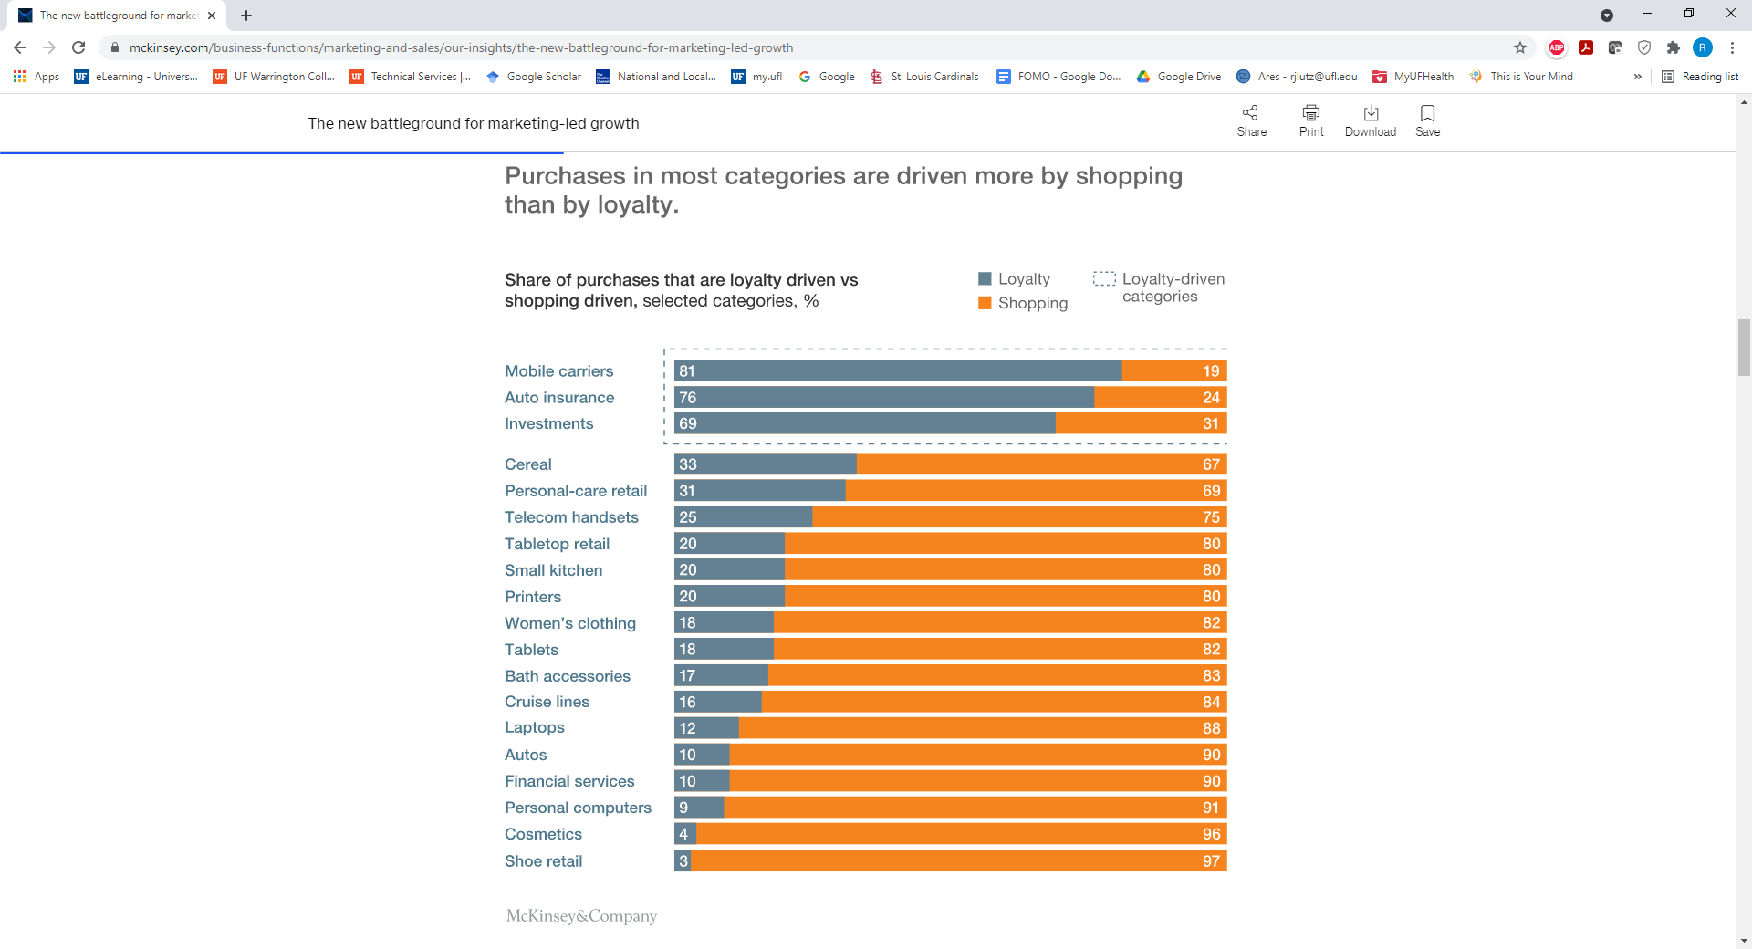
Loyalty Eroding

Slide 7
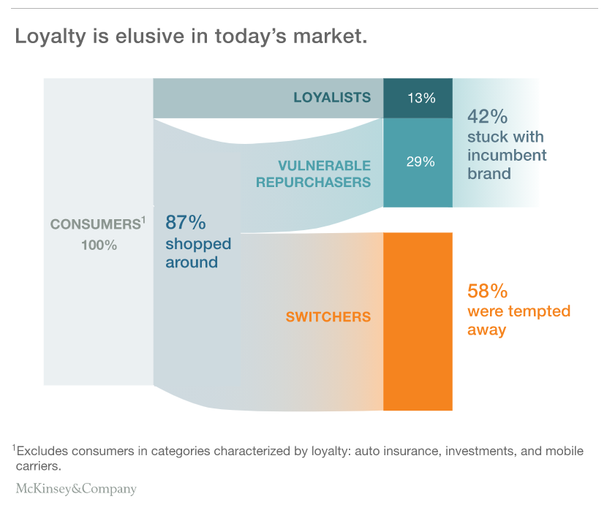
Loyalty is Increasingly Elusive

Slide 8
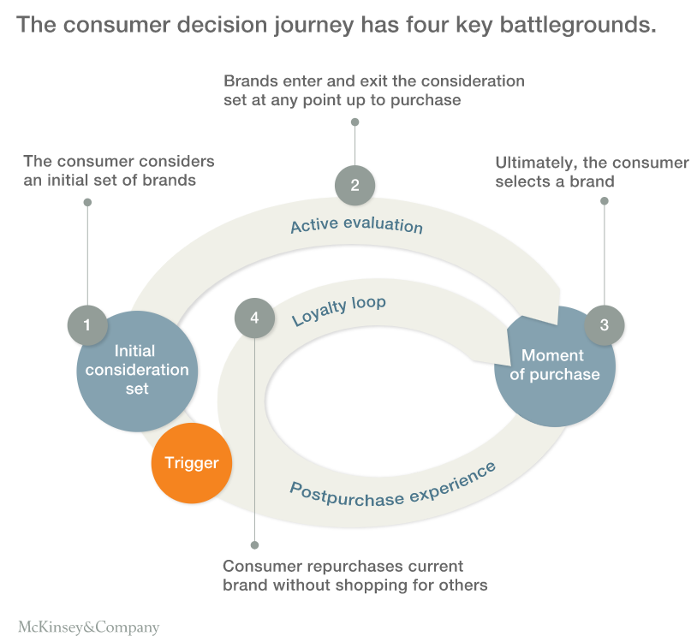
Loyalty “Loop”

Slide 9
Creating Brand Loyalty
Treat the customer right
Stay close to the customer
Measure and manage customer satisfaction
Create switching costs
Provide “extras”
BRAND
LOYALTY

Slide 10
Conclusion: How Does Your Brand Stack Up On…
Customer retention and loyalty?
Do your customers recommend you to others?

Slide 11
End of Lecture

